Slide 1

Intro-Machine Learning Clustering (2)
Fosca Giannotti
Revisited slides from Lecture Notes for Chapter 7 “Introduction to Data Mining”, 2nd Edition by Tan, Steinbach, Karpatne, Kumar

Slide 2
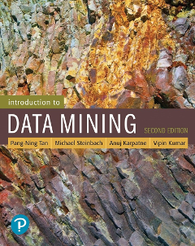
References
Clustering. Chapter 7. Introduction to Data Mining.

Slide 3
Types of Clusters
Well-separated clusters
Center-based clusters
Contiguous clusters
Density-based clusters

Slide 4
Types of Clusters: Density-Based
Density-based
A cluster is a dense region of points, which is separated by low-density regions, from other regions of high density.
Used when the clusters are irregular or intertwined, and when noise and outliers are present.
6 density-based clusters

Slide 5
DBSCAN
first DBSCAN Paper: Ester, M., et al. (1996). "A density-based algorithm for discovering clusters in large spatial databases with noise." KDD-96

Slide 6
DBSCAN
DBSCAN is a density-based algorithm.
Density = number of points within a specified radius (Eps)
A point is a core point if it has at least a specified number of points (MinPts) within Eps (2 parameters)
These are points that are at the interior of a cluster
Counts the point itself
A border point is not a core point, but is in the neighborhood of a core point
A noise point is any point that is not a core point or a border point

Slide 7
DBSCAN: Core, Border, and Noise Points
MinPts = 7

Slide 8
DBSCAN Algorithm
1: Label all points as core, border, or noise points.
2: Eliminate noise points.
3: Put an edge between all core points within a distance Eps of each other.
4: Make each group of connected core points into a separate cluster.
5: Assign each border point to one of the clusters of its associated core p

Slide 9
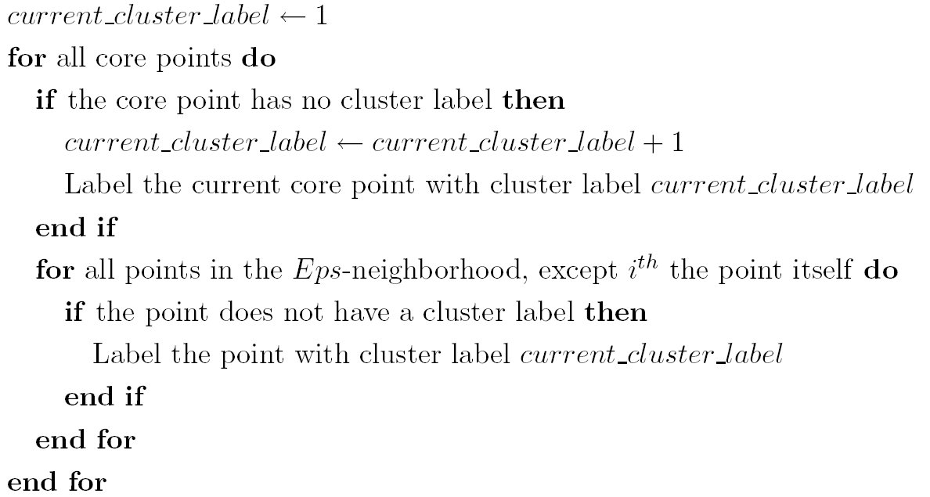
DBSCAN Algorithm
Eliminate noise points
Perform clustering on the remaining points

Slide 10
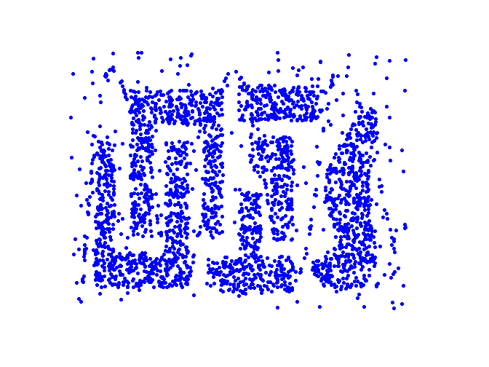
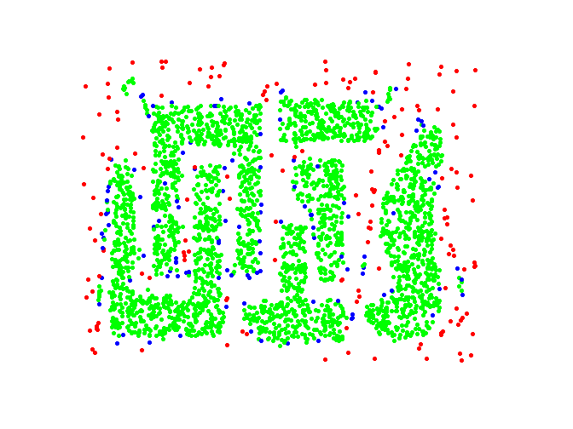
DBSCAN: Core, Border and Noise Points
Original Points
Point types: core, border and noise
Eps = 10, MinPts = 4

Slide 11
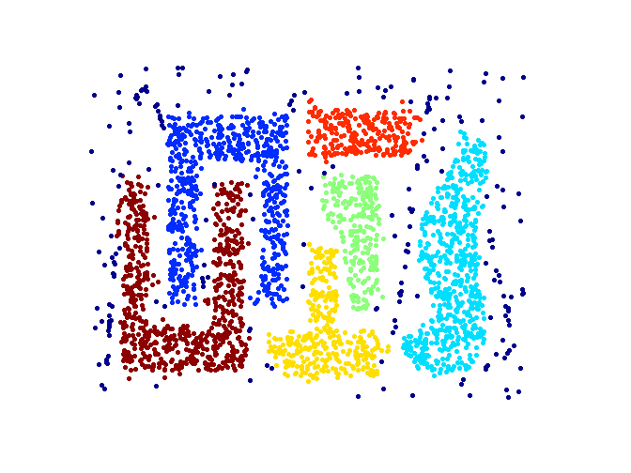
When DBSCAN Works Well
Original Points
Clusters
Resistant to Noise
Can handle clusters of different shapes and sizes

Slide 12
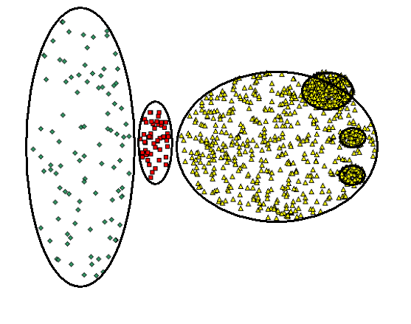
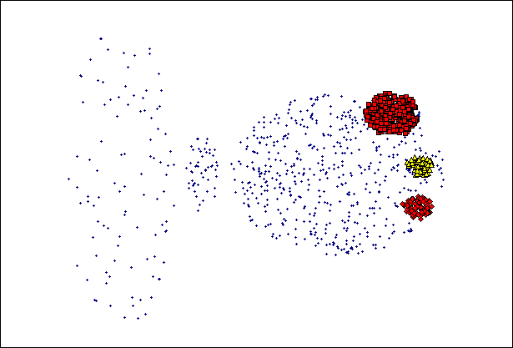
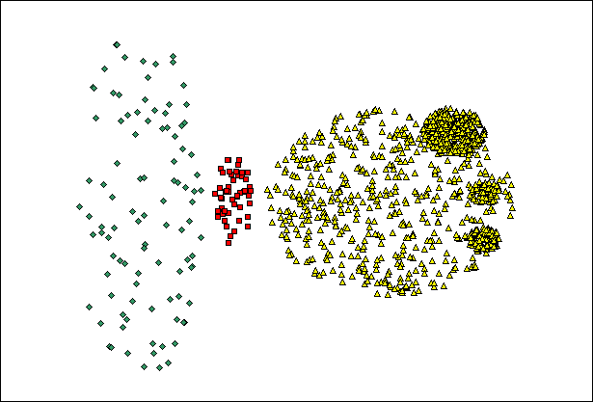
When DBSCAN Does NOT Work Well
(MinPts=4, Eps=9.92 ).
Original Points
Varying densities
High-dimensional data
(MinPts=4, Eps=9.75)

Slide 13
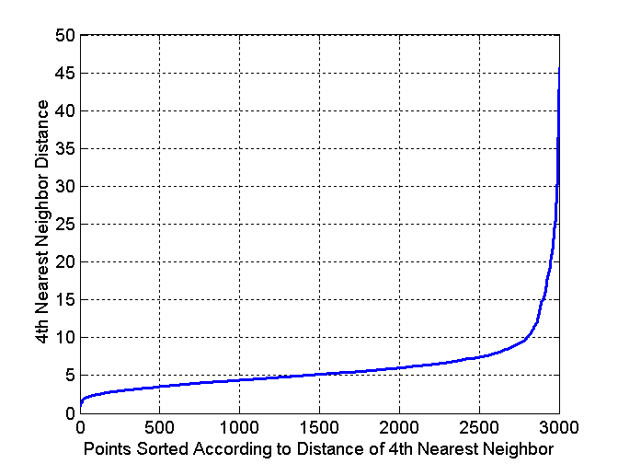
DBSCAN: Determining EPS and MinPts
Idea is that for points in a cluster, their k^{th} nearest neighbors are at roughly the same distance
Noise points have the k^{th} nearest neighbor at farther distance
So, plot sorted distance of every point to its k^{th} nearest neighbor

Slide 14
DBSCAN: resources
https://medium.com/@1rn22cd100.sujithg/dbscan-the-density-based-clustering-algorithm-that-thinks-outside-the-box-80b6837cad67

Slide 15
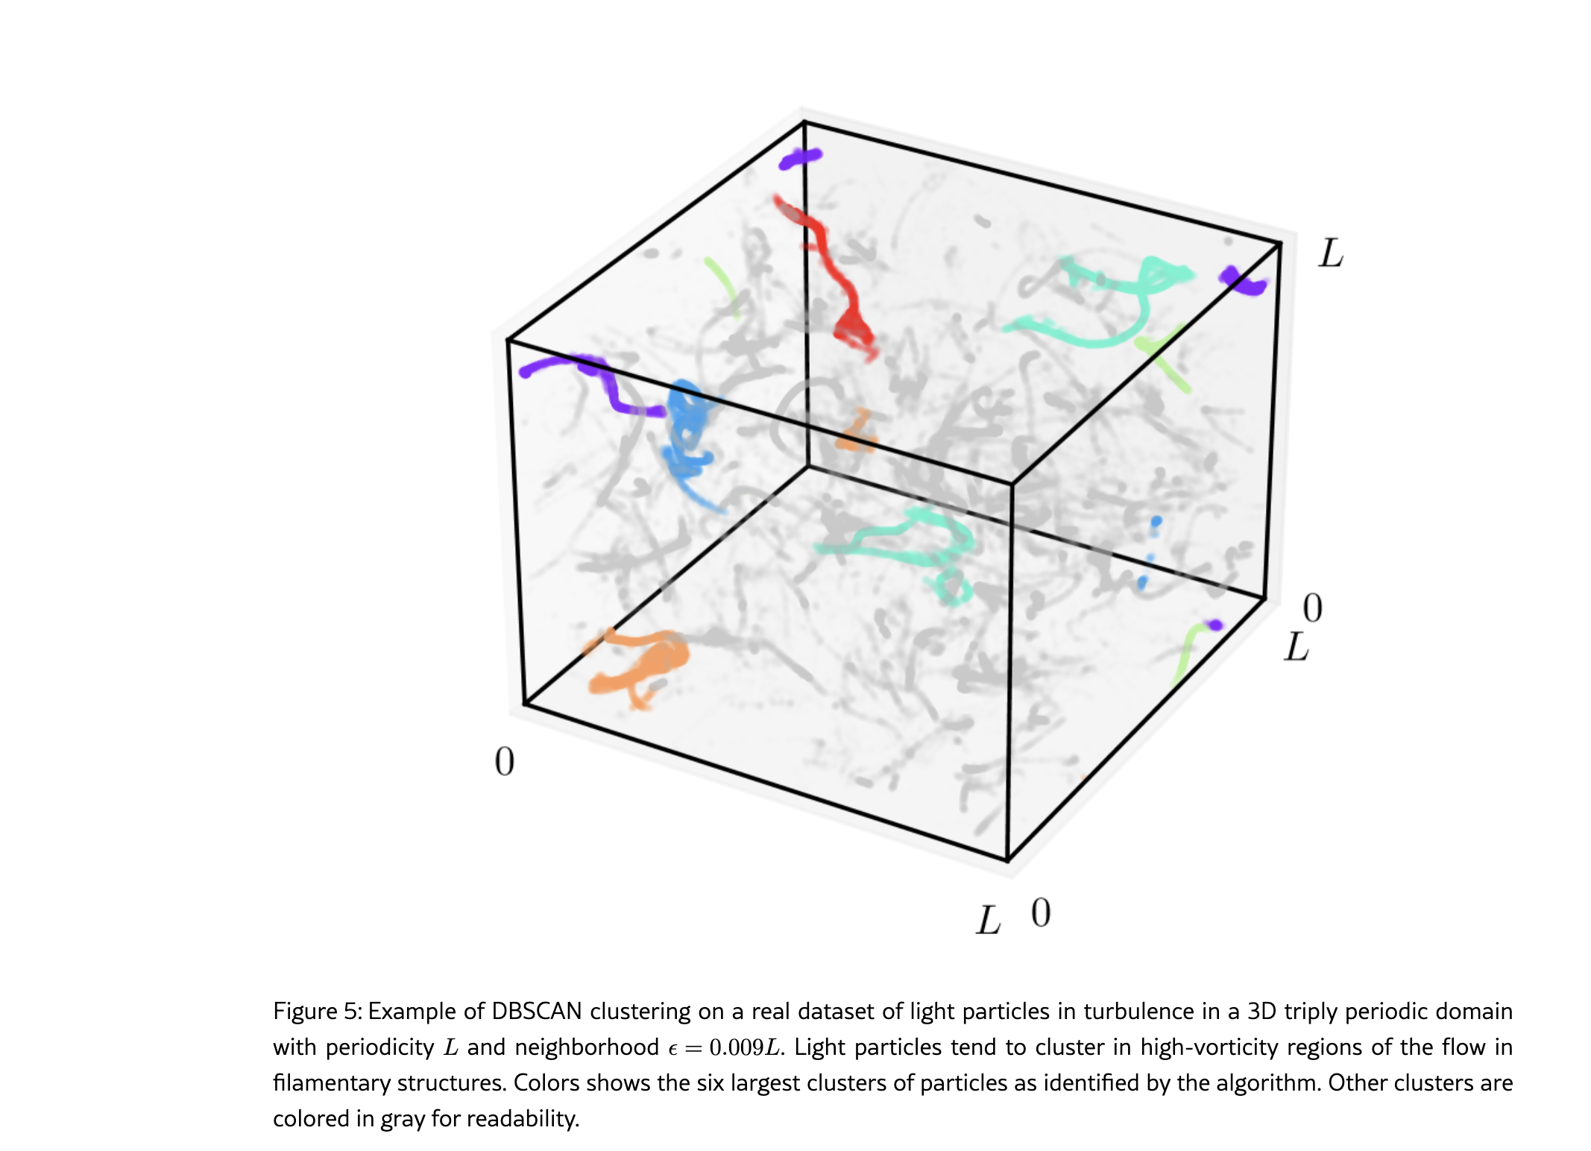
DBSCAN in domains with periodic boundary conditions
example, in fluid dynamics or molecular dynamics simulations [7] where the space of movement has boundaries

Slide 16
HIERARCHICAL CLUSTERING

Slide 17
Hierarchical Clustering
Produces a set of nested clusters organized as a hierarchical tree
Can be visualized as a dendrogram
A tree like diagram that records the sequences of merges or splits

Slide 18
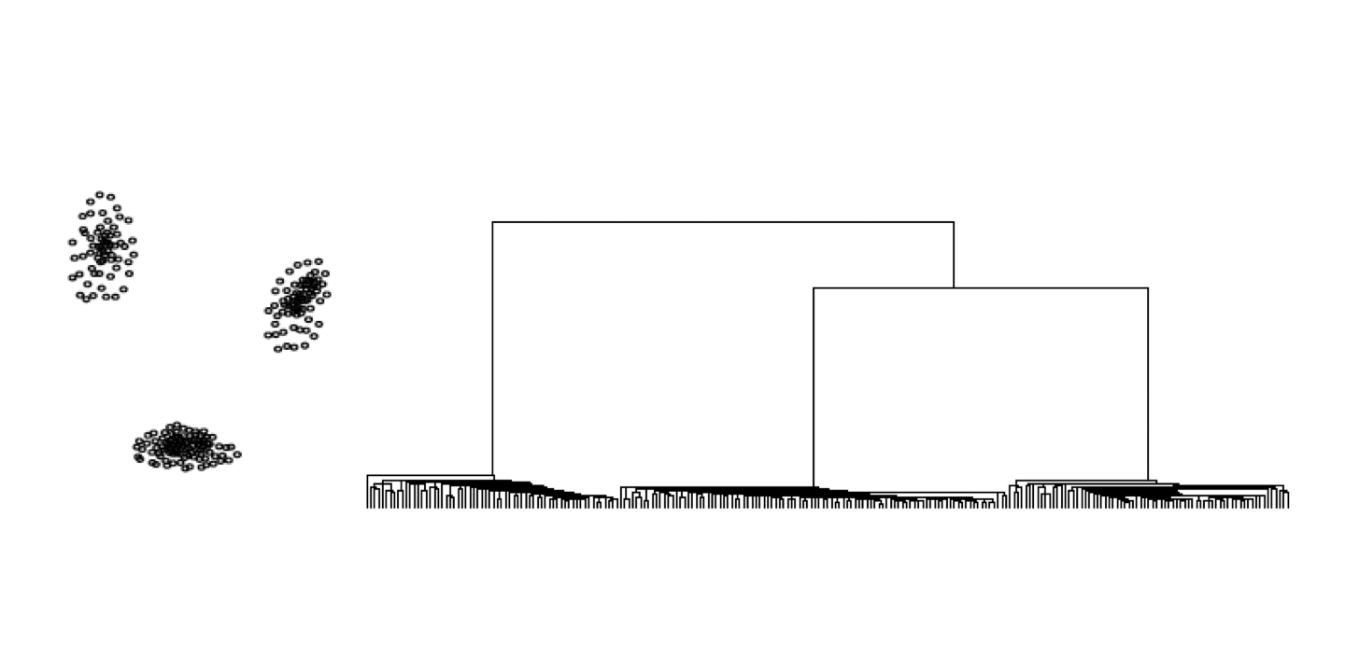
Dendrograms

Slide 19
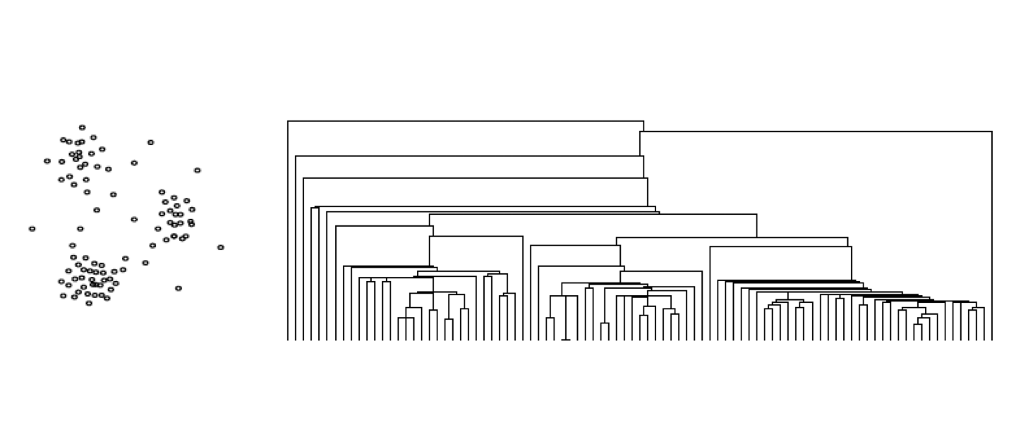
Dendrograms

Slide 20
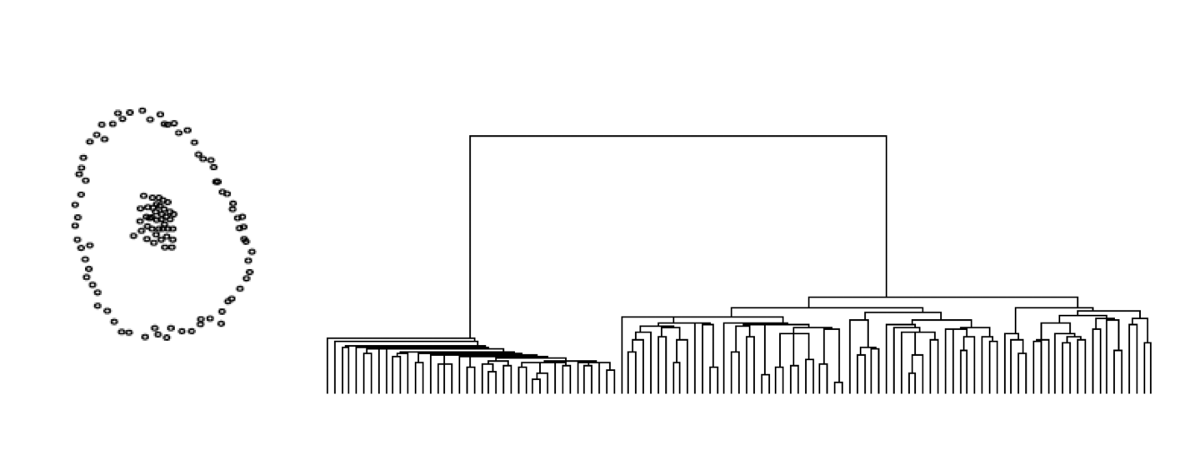
Dendrograms

Slide 21
Strengths of Hierarchical Clustering
Do not have to assume any particular number of clusters
Any desired number of clusters can be obtained by ‘cutting’ the dendrogram at the proper level
They may correspond to meaningful taxonomies
Example in biological sciences (e.g., animal kingdom, phylogeny reconstruction, …)

Slide 22
Hierarchical Clustering
Two main types of hierarchical clustering
Agglomerative:
Start with the points as individual clusters
At each step, merge the closest pair of clusters until only one cluster (or k clusters) left
Divisive:
Start with one, all-inclusive cluster
At each step, split a cluster until each cluster contains an individual point (or there are k clusters)
Traditional hierarchical algorithms use a similarity or distance matrix
Merge or split one cluster at a time

Slide 23
Agglomerative Clustering Algorithm
Most popular hierarchical clustering technique
Basic algorithm is straightforward
Compute the proximity matrix
Let each data point be a cluster
Repeat
Merge the two closest clusters
Update the proximity matrix (merge two columns and two rows also in the dendogram)
Until only a single cluster remains
Key operation is the computation of the proximity of two clusters
Different approaches to defining the distance between clusters distinguish the different algorithms

Slide 24
Starting Situation
Start with clusters of individual points and a proximity matrix
p1
p2
p3
p4
p5
. . .
p1
p2
p3
p4
p5
.
.
.
Proximity Matrix

Slide 25
Intermediate Situation
After some merging steps, we have some clusters
C1
C2
C3
C4
C5
C1
C2
C3
C3
C4
C4
C5
Proximity Matrix
C1
C2
C5

Slide 26
Intermediate Situation
We want to merge the two closest clusters (C2 and C5) and update the proximity matrix.
C1
C2
C3
C4
C5
C1
C2
C3
C3
C4
C4
C5
Proximity Matrix
C1
C2
C5

Slide 27
After Merging
The question is “How do we update the proximity matrix?”
C2 U C5
C1
C3
C4
C1
?
C2 U C5
? ? ? ?
C3
C3
?
C4
C4
?
Proximity Matrix
C1
C2 U C5

Slide 28
How to Define Inter-Cluster Distance
p1
p2
p3
p4
p5
. . .
p1
Similarity?
p2
p3
p4
p5
MIN
MAX
Group Average
Distance Between Centroids
Other methods driven by an objective function
Ward’s Method uses squared error
.
.
.
Proximity Matrix

Slide 29
How to Define Inter-Cluster Similarity
p1
p2
p3
p4
p5
. . .
p1
p2
p3
p4
p5
MIN
MAX
Group Average
Distance Between Centroids
Other methods driven by an objective function
Ward’s Method uses squared error
.
.
.
Proximity Matrix

Slide 30
How to Define Inter-Cluster Similarity
p1
p2
p3
p4
p5
. . .
p1
p2
p3
p4
p5
MIN
MAX
Group Average
Distance Between Centroids
Other methods driven by an objective function
Ward’s Method uses squared error
.
.
.
Proximity Matrix

Slide 31
How to Define Inter-Cluster Similarity
p1
p2
p3
p4
p5
. . .
p1
p2
p3
p4
p5
MIN
MAX
Group Average
Distance Between Centroids
Other methods driven by an objective function
Ward’s Method uses squared error
.
.
.
Proximity Matrix

Slide 32
How to Define Inter-Cluster Similarity
p1
p2
p3
p4
p5
. . .
p1
×
×
p2
p3
p4
p5
MIN
MAX
Group Average
Distance Between Centroids
Other methods driven by an objective function
Ward’s Method uses squared error
.
.
.
Proximity Matrix

Slide 33
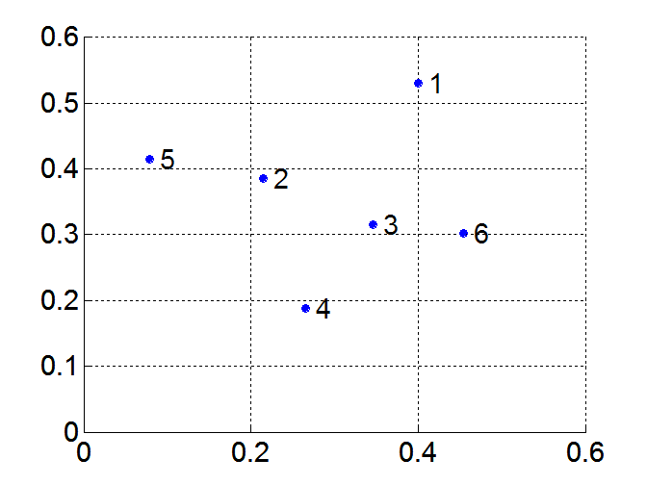
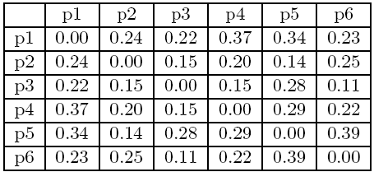
MIN or Single Link
Proximity of two clusters is based on the two closest points in the different clusters
Determined by one pair of points, i.e., by one link in the proximity graph
Example:
Distance Matrix:

Slide 34
Hierarchical Clustering: MIN
5
1
3
5
2
1
2
3
6
4
4
Nested Clusters
Dendrogram

Slide 35
Strength of MIN
Original Points
Six Clusters
Can handle non-elliptical shapes

Slide 36
Limitations of MIN
Two Clusters
Original Points
Sensitive to noise and outliers
Three Clusters

Slide 37


MAX or Complete Linkage
Proximity of two clusters is based on the two most distant points in the different clusters
Determined by all pairs of points in the two clusters
Distance Matrix:

Slide 38
Hierarchical Clustering: MAX
4
1
2
5
5
2
3
6
3
1
4
Nested Clusters
Dendrogram

Slide 39
Strength of MAX
Original Points
Two Clusters
Less susceptible to noise and outliers

Slide 40
Limitations of MAX
Original Points
Two Clusters
Tends to break large clusters
Biased towards globular clusters

Slide 41
Group Average
Proximity of two clusters is the average of pairwise proximity between points in the two clusters.
Need to use average connectivity for scalability since total proximity favors large clusters
Distance Matrix:

Slide 42
Hierarchical Clustering: Group Average
5
4
1
2
5
2
3
6
1
4
3
Nested Clusters
Dendrogram

Slide 43
Hierarchical Clustering: Group Average
Compromise between Single and Complete Link
Strengths
Less susceptible to noise and outliers
Limitations
Biased towards globular clusters

Slide 44
Cluster Similarity: Ward’s Method
Similarity of two clusters is based on the increase in squared error when two clusters are merged
Similar to group average if distance between points is distance squared
Less susceptible to noise and outliers
Biased towards globular clusters
Hierarchical analogue of K-means
Can be used to initialize K-means

Slide 45
Hierarchical Clustering: Comparison
5
1
4
1
3
2
5
5
5
2
1
MIN
2
MAX
2
3
6
3
3
6
1
4
4
4
5
5
1
4
1
2
2
5
2
Ward’s Method
5
2
3
6
Group Average
3
3
6
4
1
1
4
4
3

Slide 46
Cluster Validity

Slide 47
Cluster Validity
How to evaluate the “goodness” of the resulting clusters?
But “clusters are in the eye of the beholder”!
Then why do we want to evaluate them?
To avoid finding patterns in noise
To compare clustering algorithms
To compare two sets of clusters
To compare two clusters

Slide 48
Clusters found in Random Data
Random Points
DBSCAN
K-means
Complete Link

Slide 49
Different Aspects of Cluster Validation
Determining the clustering tendency of a set of data, i.e., distinguishing whether non-random structure actually exists in the data.
Comparing the results of a cluster analysis to externally known results, e.g., to externally given class labels.
Evaluating how well the results of a cluster analysis fit the data without reference to external information.
- Use only the data
Comparing the results of two different sets of cluster analyses to determine which is better.
Determining the ‘correct’ number of clusters.
For 2, 3, and 4, we can further distinguish whether we want to evaluate the entire clustering or just individual clusters.

Slide 50
Measures of Cluster Validity
Numerical measures that are applied to judge various aspects of cluster validity, are classified into the following three types.
External Index: Used to measure the extent to which cluster labels match externally supplied class labels.
Entropy
Internal Index: Used to measure the goodness of a clustering structure without respect to external information.
Sum of Squared Error (SSE)
Relative Index: Used to compare two different clusterings or clusters.
Often an external or internal index is used for this function, e.g., SSE or entropy
Sometimes these are referred to as criteria instead of indices
However, sometimes criterion is the general strategy and index is the numerical measure that implements the criterion.

Slide 51
Measuring Cluster Validity Via Correlation
Two matrices
Proximity Matrix
Ideal Similarity Matrix
One row and one column for each data point
An entry is 1 if the associated pair of points belong to the same cluster
An entry is 0 if the associated pair of points belongs to different clusters
Compute the correlation between the two matrices
Since the matrices are symmetric, only the correlation between n(n-1) / 2 entries needs to be calculated.
High correlation indicates that points that belong to the same cluster are close to each other.
Not a good measure for some density or contiguity based clusters.

Slide 52
Measuring Cluster Validity Via Correlation
Correlation of ideal proximity (same can be done for similarity) matrices for the K-means clusterings of the following two data sets.
Corr = -0.9235
Corr = -0.5810

Slide 53
Using Proximity Matrix for Cluster Validation
Order the proximity matrix with respect to cluster labels and inspect visually. (cohesion and separation)

Slide 54
Using proximity Matrix for Cluster Validation (cohesion and separation)
Clusters in random data are not so crisp
DBSCAN

Slide 55
Using Similarity Matrix for Cluster Validation
Clusters in random data are not so crisp
K-means

Slide 56
Using Proximity Matrix for Cluster Validation
Clusters in random data are not so crisp
Complete Link

Slide 57
Using Proximity Matrix for Cluster Validation
DBSCAN
What about cohesion and separation??
Notes:
no cohesion no well separation

Slide 58
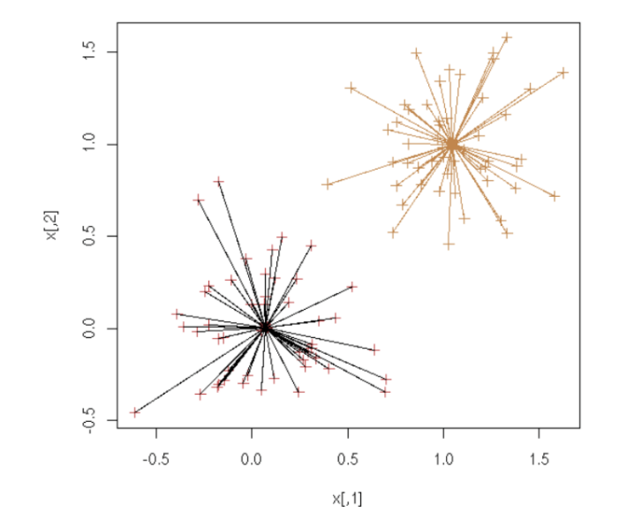
Internal Measures: SSE (cohesion)
Clusters in more complicated figures aren’t well separated
Internal Index: Used to measure the goodness of a clustering structure without respect to external information
SSE is good for comparing two clusterings or two clusters (average SSE).
Can also be used to estimate the number of clusters

Slide 59
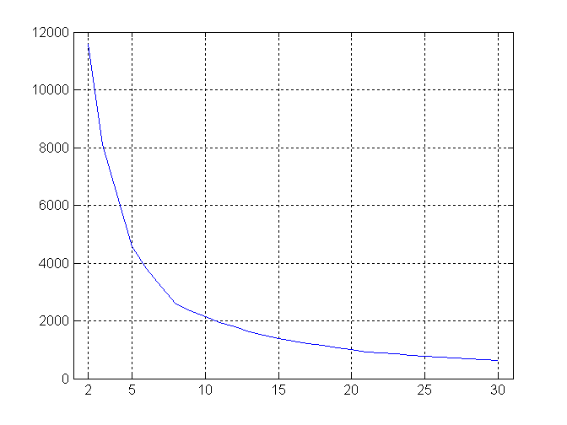
Internal Measures: SSE
SSE curve for a more complicated data set
SSE of clusters found using K-means

Slide 60
Framework for Cluster Validity
Need a framework to interpret any measure.
For example, if our measure of evaluation has the value, 10, is that good, fair, or poor?
Statistics provide a framework for cluster validity
The more “atypical” a clustering result is, the more likely it represents valid structure in the data
Can compare the values of an index that result from random data or clusterings to those of a clustering result.
If the value of the index is unlikely, then the cluster results are valid
These approaches are more complicated and harder to understand.
For comparing the results of two different sets of cluster analyses, a framework is less necessary.
However, there is the question of whether the difference between two index values is significant

Slide 61
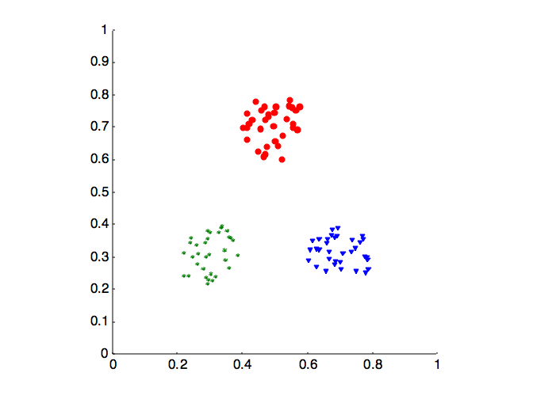
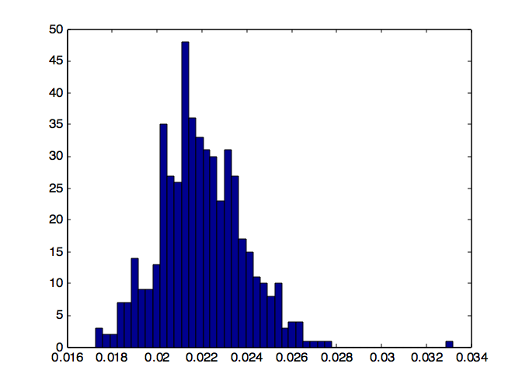
Statistical Framework for SSE
Example
Compare SSE of 0.005 against three clusters in random data
Histogram shows SSE of three clusters in 500 sets of random data points of size 100 distributed over the range 0.2 – 0.8 for x and y values

Slide 62
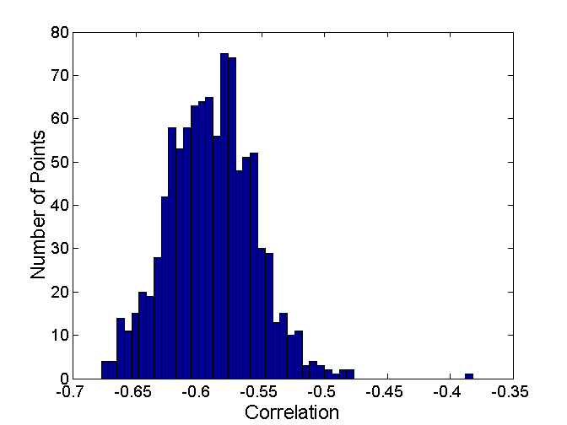
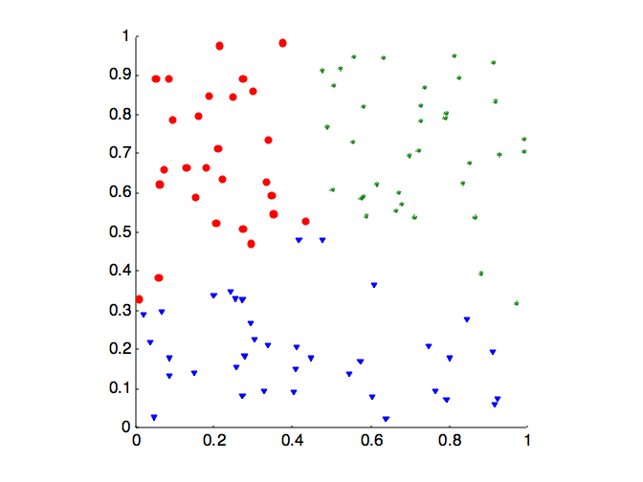
Statistical Framework for Correlation
Correlation of incidence and proximity matrices for the K-means clusterings of the following two data sets.
Corr = -0.9235
Corr = -0.5810

Slide 63
Internal Measures: Cohesion and Separation
Cluster Cohesion: Measures how closely related are objects in a cluster
Example: SSE
Cluster Separation: Measure how distinct or well-separated a cluster is from other clusters
Example: Squared Error
Cohesion is measured by the within cluster sum of squares (SSE)
Separation is measured by the between cluster sum of squares
Where |C_{i}| is the size of cluster i

Slide 64
Internal Measures: Cohesion and Separation
A proximity graph based approach can also be used for cohesion and separation.
Cluster cohesion is the sum of the weight of all links within a cluster.
Cluster separation is the sum of the weights between nodes in the cluster and nodes outside the cluster.
cohesion
separation

Slide 65
Internal Measures: Silhouette Coefficient
Silhouette coefficient combines ideas of both cohesion and separation, but for individual points, as well as clusters and clusterings
For an individual point, i
Calculate a = average distance of i to the points in its cluster
Calculate b = min (average distance of i to points in another cluster)
The silhouette coefficient for a point is then given by s = (b – a) / max(a,b)
Typically between 0 and 1.
The closer to 1 the better.
Can calculate the average silhouette coefficient for a cluster or a clustering

Slide 66
Final Comment on Cluster Validity
“The validation of clustering structures is the most difficult and frustrating part of cluster analysis.
Without a strong effort in this direction, cluster analysis will remain a black art accessible only to those true believers who have experience and great courage.”
Algorithms for Clustering Data, Jain and Dubes

Slide 67
References
Clustering. Chapter 7. Introduction to Data Mining.

